Slide 1
Actions 4 ACEs Campaign Presentation
[NAME]
[ORGANIZATION]
[DATE]

Slide 2
“New Jersey is a leader across the nation in identifying ACEs as a public health crisis in need of attention and intervention. It’s only through awareness that we can begin to heal and build resilience in our communities. I’m thankful for the breadth of partners we have committed to the hard, heart work ahead of us.”
– Dave Ellis, Executive Director, Office of Resilience, New Jersey Department of Children and Families

Slide 3
Understanding Adverse Childhood Experiences (ACEs)

Slide 4
About ACEs
ACEs, or adverse childhood experiences, are stressful or traumatic events that occur before the age of 18
They include experiences such as divorce, witnessing violence or physical, emotional and sexual abuse
Adverse community events such as poverty, poor housing quality, and systemic racism can further compound the effects of ACEs
A landmark study found the higher the number of ACEs, the more likely one can experience negative health effects like heart disease, diabetes, stroke, depression, anxiety, and asthma
The Pair of ACEs: Adverse Childhood Experiences and Adverse Community Environments
Image Adapted from Ellis., W.R and Dietz, W.H

Slide 5
The Burden of ACEs
The economic cost of ACEs in North America is estimated to be over $700 billion annually¹
Nationally, 2 out of 3 children have experienced at least one ACE²
61% of adults surveyed across 25 states reported that they had at least one type of adverse childhood trauma³
At least 5 of the 10 top leading causes of death are associated with ACEs⁴
Preventing ACEs could reduce the number of adults with depression by as much as 44% ⁴
¹ Bellis, M.A., Hughes, K., Ford, K., Ramos Rodriguez, G., Sethi, D., and Passmore, J. (2019). Life Course Health Consequences and Associated Annual Costs of Adverse Childhood Experiences across Europe and North America: A Systematic Review and Meta-analysis. Lancet Public Health 4(10), e517-e528. https://pubmed.ncbi.nlm.nih.gov/31492648/
² Substance Abuse and Mental Health Services Administration (2021, June 10). Understanding Child Trauma. https://www.samhsa.gov/child-trauma/understanding-child-trauma
³ Centers for Disease Control and Prevention. (2021, June 10). Violence Prevention Fast Facts: What are adverse childhood experiences? https://www.cdc.gov/violenceprevention/aces/fastfact.html
⁴ Centers for Disease Control and Prevention. (2019). Adverse Childhood Experiences (ACEs): Preventing Early Trauma to Improve Adult Health. Vital Signs, November 2019. https://www.cdc.gov/vitalsigns/aces/pdf/vs-1105-aces-H.pdf

Slide 6
The Science of ACEs
ACEs can change our brains and bodies
ACEs can alter children’s brains and bodies in ways that can cause behavioral problems, learning difficulties and physical health issues
Early adversity can have a lifelong impact
When faced with early adversity and trauma, children are at a higher risk of developing chronic illness as an adult or experiencing an earlier death
As adults, children impacted by ACEs can have an increased risk of developing chronic diseases, such as cancer, diabetes, and heart disease
Caring and competent adults can help children heal from the impact of ACEs
Building positive relationships with caring and competent adults can help a child heal from the impact of ACEs, build a sense of belonging, and increase connections to community, culture and spirituality

Slide 7
Addressing ACEs in New Jersey
In New Jersey, many diverse agencies are already addressing ACEs, often through partnerships, to help prevent, protect against, and heal from the harmful effects of ACEs
The NJ ACEs Collaborative identified five areas of opportunity for continued work and action¹
Support parents and caregivers
Provide training and professional development in trauma-informed care
Promote community awareness of ACEs
Advance policies and practices that help children and families thrive
Collect, analyze, and share data findings from research and practice
Areas of Opportunity for Addressing ACEs in New Jersey
¹ NJ ACEs Collaborative (2019). Adverse Childhood Experiences: Opportunities to Prevent, Protect Against, and Heal from the Effects of ACEs in New Jersey. http://aces-report.burkefoundation.org/.

Slide 8
Addressing ACEs in New Jersey
Key Statewide Activities to Date
The New Jersey Department of Children and Families (DCF) released the NJ ACEs Statewide Action Plan in February 2021 detailing a path toward making New Jersey a trauma-informed/healing centered state
The NJ ACEs Collaborative created the NJ Resiliency Coalition Community as an active virtual learning center that convenes people living and working in the state around solutions for preventing ACEs
The NJ Office of the Attorney General issued a statewide Handle With Care (HWC) program promoting partnerships between schools and law enforcement to help children facing trauma

Slide 9
Actions 4 ACEs Campaign Overview

Slide 10
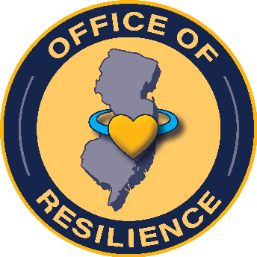
The New Jersey ACEs Collaborative
The Actions 4 ACEs campaign is an initiative guided by the New Jersey ACEs Collaborative, a public-private partnership consisting of The Burke Foundation, The Nicholson Foundation, the Turrell Fund, the New Jersey Department of Children and Families and the New Jersey Office of Resilience

Slide 11
About the Campaign
Actions 4 ACEs aims to increase public awareness of ACEs and encourage adoption of behaviors that can mitigate the impact ACEs can have on children, families and communities
MISSION: Building resilience in children, families and communities
VISION: To make New Jersey a trauma-informed, healing-centered state – a place where children and familied can thrive
INITIAL AUDIENCE: Law enforcement professionals and education professionals (serving grades Pre-K through 12)

Slide 12
Goals and Objectives
By campaign end, educators and law enforcement officers in New Jersey will report having increased:
Knowledge of ACEs, including causes, prevalence and impact
Understanding of the benefits of addressing ACEs
Knowledge of how to respond in a supportive way when interacting with someone who has experienced ACEs
Awareness of tools, programs, and services available to help priority audiences learn more about ACEs and how to respond
With statewide increases in:
Number of people trained on ACEs, specifically among law enforcement and education professionals, specifically Handle With Care and ACE Interface
Number of partnerships among education and law enforcement stakeholders to address ACEs

Slide 13
Mobilizing Partners to Raise Awareness
Addressing ACEs takes all of us. Our invaluable partners bring awareness to this statewide issue and educate those working closest with children on the positive impact they can make.
Amplifying the Community’s Voice through our Community Advisory Board
The community is at the forefront of the work to address ACEs, build trust and create lasting change
In creating this campaign, the NJ ACEs Community Advisory Board – comprised of individuals from a variety of sectors – have provided provide valuable insights, advice and connections to their respective communities
Building a Robust Partner Ecosystem
A robust network of partners is working to increase recognition of ACEs as a public health issue that must and can be addressed in New Jersey
Partners are finding creative ways to increase awareness and amplify Actions 4 ACEs messages among priority audiences

Slide 14
Campaign Pillars
Partner Ecosystem
Community Voice and Input
Statewide Activation
Materials Development
Website/
Resource Hub
Training
Earned Media
Paid Media
Social Media

Slide 15
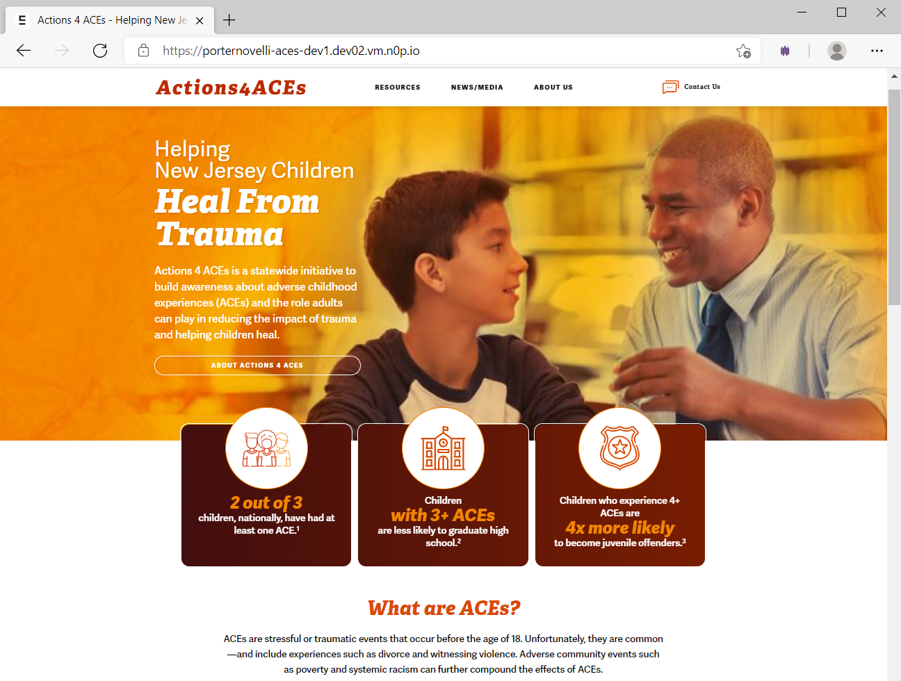
Campaign Resources – Website
Visit Actions4ACEs.com to access the latest campaign information and resources
Campaign Mission and Vision
Educational Materials and Resources
News and Updates about Efforts to Address ACEs in NJ
Calendar of Events
Role of Community and Partners

Slide 16
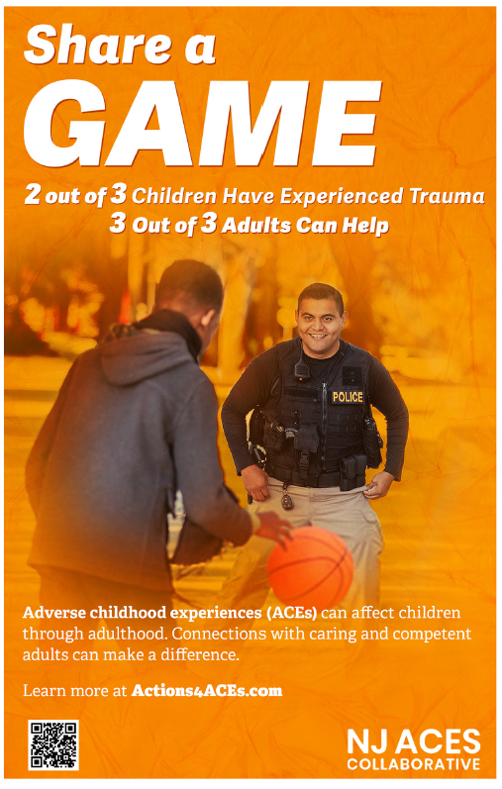
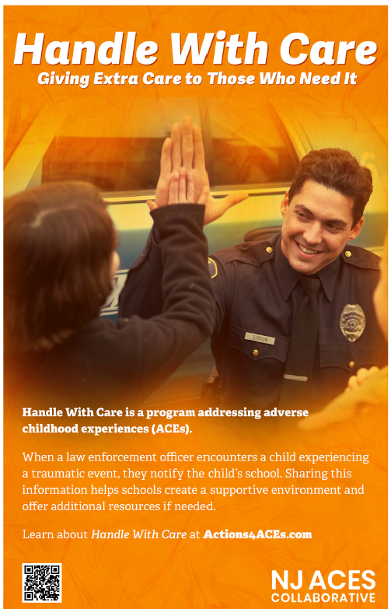
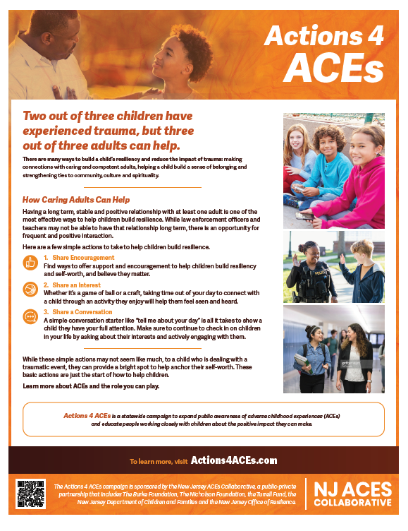
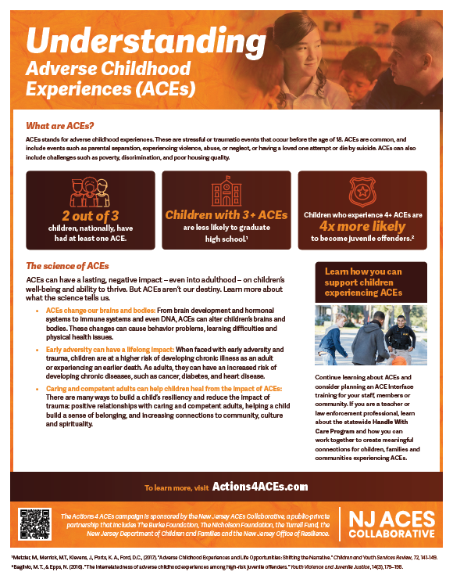
Campaign Resources – Print Materials
The campaign’s print resources can be downloaded for print or shared electronically to help increase awareness among educators and law enforcement professionals
Posters
Law Enforcement
Educators
Handle With Care
Fact Sheets
Understanding ACEs
Actions 4 ACEs
Flyers / Print Display Ads

Slide 19
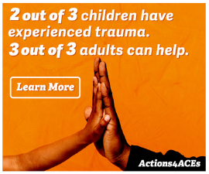
Campaign Resources – Digital Tools
Actions 4 ACEs has digital tools to you help spread the word about ACEs and the campaign online
Social Media Toolkit
Share the campaign’s social media assets (graphics and sample messages) to help amplify the campaign online
Campaign Video (Coming Soon)
Share the campaign’s 30-second video to help increase awareness about ACEs and the campaign
Digital Banner
Dedicate space on your website to the campaign by using our available digital banner

Slide 20
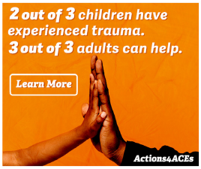
Get Involved, Become a Partner
To learn how to get involved by becoming a partner, contact info@Actions4ACEs.com or visit the campaign website
Download the Actions 4 ACEs Partner Toolkit for resources and messages you can incorporate into your outreach, including:
Posters and fact sheets
Newsletter blurbs
Sample social media posts
Sample public service announcement (PSA) scripts

Slide 21
Additional Resources
Visit the following sites for additional information:
New Jersey Resiliency Coalition Community – The NJ Resiliency Coalition site will help you stay connected to efforts in New Jersey to build a resilient state through community collaboration https://www.pacesconnection.com/g/NJ-Resiliency-Coalition
State of New Jersey Office of Resilience – As a part of the State of New Jersey Department of Children and Families (DCF), the Office of Resilience hosts, coordinates and facilitates statewide initiatives related to raising awareness of and creating opportunities to eradicate ACEs, through grassroots and community-led efforts, and support for organizations pursuing this work https://www.nj.gov/dcf/resilience.html

Slide 22
Thank You to Our Partners!

Slide 23
Questions and Answers
For additional questions, email info@Actions4ACEs.com

